Slide 1
Software Development Methodologies – The others
Go through the other methodologies that are not scrum or waterfall (quickly)
Nike
Phased Waterfall
V Model
Spiral
RAD (Rapid Application Development)
DSDM (No idea)
RUP (Rational Unified Design)
Kanban

Slide 2
Software Development Methodologies – Nike*
The “Just do it” approach.
Sit down, scribble a design on a scrap paper, start coding+testing
Pros
Can be very efficient in some circumstances e.g. simple well understood problem
Cons
Only works for very small team (e.g. 1 maybe 2 people)
The team members still need to cover all the main roles (customer, SME, BA, dev and test)
Does not work with complex problems
Does not scale
Quality not ensured
*I just made this methodology up. Do not quote it in an exam!

Slide 3
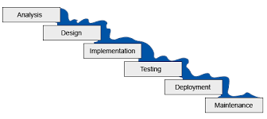



Software Development Methodologies – Phased Waterfall
In practice the PM normally says “we can not deliver all functionality that in that time”. So she then proposes delivering bits of it in phases over a longer period.
Each phase may be a 3-6 months. It’s almost iterative!
Deliver and get feedback
Deliver and get feedback
Deliver and get feedback
Phase 1
Phase 2
Phase 3

Slide 4
Software Development Methodologies – Phased Waterfall
Pros
Allows testing and customer feedback at the end of each stage
Cons
Still significant upfront analysis and design required
The team can end up supporting, fixing defects, and maintaining the previous phase instead of developing the next
The feedback and defects are rarely included in the PMs plan

Slide 5
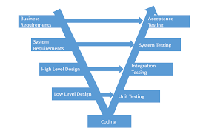
Software Development Methodologies – V model
A weakness of waterfall is that the last stage in any sequential process tends to get squeezed when time is short (always), i.e. testing.
V model based on Waterfall but with focus on testing (don’t leave it until last)
Write the relevant test spec at each stage
Similar ideas as TDD. Tests first approach.
Pros
Focus on testing improves quality
Cons
Test still not run until coding complete
No feedback from failed tests or customer until late in the process
Aka – Validation Model or Verification Model

Slide 6

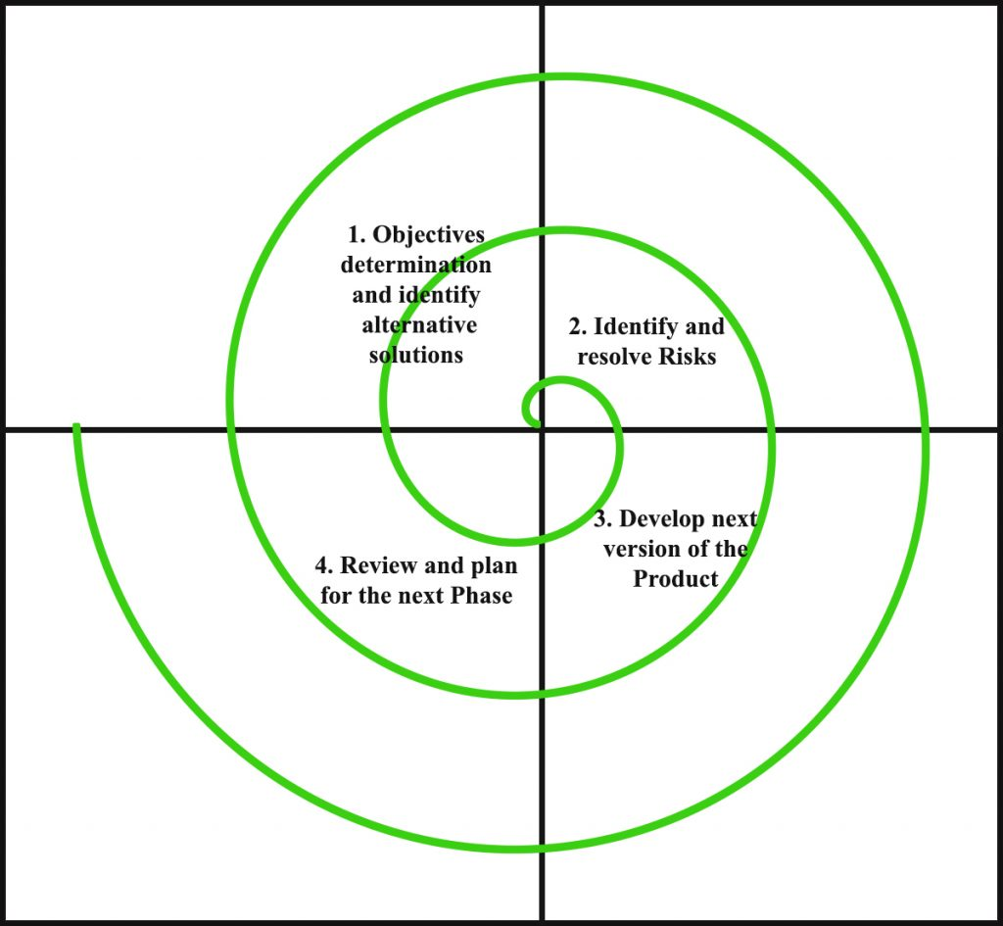
Software Development Methodologies - Spiral
Use the risk pattern of a project to decide what model to actually use (could use waterfall during the build quadrant)
Each loop produces a product with increasing scope/completeness?
Both sequential and incremental?
Use for risky, complex, ill defined projects?
Design
Identification
Pros
Use sees product and can feedback
Risky parts done early?
Cons
Complex management
Complex process
Lots of docs
Evaluate/analysis risk
Build

Slide 7

Software Development Methodologies - RAD
Rapid Application Development (RAD). Is really a group of adaptive/agile methods (Spiral is RAD!)
Often driven by UI requirements (RAD tools)
Early prototyping?
Pros
Fast user feed back
Better quality?
Risk control
Cons*
Needs commitment from key resources (customers/experts/etc)
Less (management?) control
Poor design? Hack and test?
Poor scalability
*All classic adaptive/agile problems, skater dudes

Slide 8

Software Development Methodologies - DSDM
Dynamic system development method (DSDM)
RAD with more discipline?
MoSCoW prioritization (musts, should, coulds, wonts)
Pros
Google it.
Cons

Slide 9

Software Development Methodologies – XP (eXtrems Programming)
Agile
Pair programming
Code reviews
Unit tests!
Flat management
Expect change
Code simplicity
YAGNI (you aint gonna need it)
Pros
What’s not to like?
Cons
Lack of structure and discipline?

Slide 10
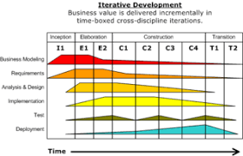
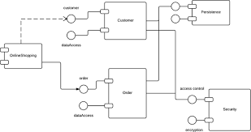
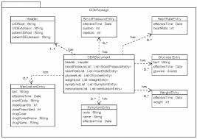
Software Development Methodologies - RUP
Rational Unified Process (RUP)
Created by IBM (Rational Software Corp)
Iterative framework
Uses UML (Unified Modeling Language)
Pros
Agile but with structure?
Cons
Complicated
Steep learning curve?

Slide 11
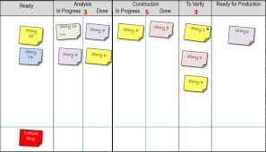
Software Development Methodologies - Kanban
Mean “signboard” in Japanese? Started as lean manufacturing system in Toyota?
Agile with “work in progress” limits
Aim to get high through put (easy to spot points at which bottlenecks occur)
Can be combined with scrum in “Scrumban” mash up
Pros
Its great
Cons
None*
*See disclaimer at start

Slide 12

Software Development Methodologies - Questions

Slide 13
Software Development Methodologies

